Slide 1
Linux – Internals

Slide 2
Linux Components
Linux Performance monitoring
Hands -on

Slide 3
Linux Core Concepts
Physical Memory
File System(Disk)
Swap
CPU
Kernel
Context switching
System calls
Interrupts
User Application/Software
Input/Output device

Slide 4
Linux Core Concepts
Kernel : It is the core operating system which interacts directly between hardware's and software’s
Context Switching – The process of suspending one running process and commencing another process to run is context switching
System calls - System calls act as intermediate between your user program and kernel. Every process running on your desktop uses system calls to communicate with the OS.
User mode - User mode is where application runs
Kernel mode - Kernel mode is where hardware resource runs,
Interrupts - When an interrupt signal arrives to the kernel, the kernel must switch a current execution process to a new one to handle the interrupt. This means interrupts cause context switching, and therefore a significant number of interrupts could cause performance degradation.
Example : Mouse click, keyboard event
CPU Scheduler - This is one of the kernel subsystem is responsible for fairly distributing the CPU resources among all the processes.

Slide 5
Linux Core Concepts
Physical Memory vs Virtual Memory
Physical Memory – RAM is the physical memory in the system
Virtual Memory – Swap space + Physical memory
If system already has 4GB of RAM, the Memory management unit can carve out additional 2GB from the HD and fake it as 6GB in total. This 6GB memory is also referred virtual memory
Pages - Page is a group of contiguous linear address in physical memory, Typically page represent just 4KB of physical memory.
Page fault - When CPU need to access the memory that isn’t available in main memory, it triggers page fault.
When a process need to access data within its address space, but it fails to load into the memory. A MMU instructs the machine to find the data block within virtual memory and that way it can be sent to physical memory from virtual memory.
Major Page fault : Only satisfying by accessing the disk
Minor Page fault : it can be satisfied by sharing pages that already in memory.

Slide 6
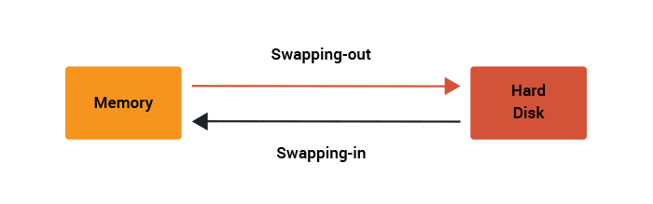
Linux Core Concepts
Swap Memory:
What happens when kernel does not have enough physical memory ?
The kernel will start to write into disk of some of the pages which is holding the memory and writing page out of disk is a slower operation. However, it is better than killing the process.
The process of writing to swap memory from Physical memory just to free-up memory is swap-out and if the page fault is raised because of the page on swap memory. Then the kernel has to read back the pages from swap into memory is swap-in.
Excessive number of Swap in/out cause the performance degradation as your system doesn’t have enough memory to hold the pages and is using disk often.

Slide 7
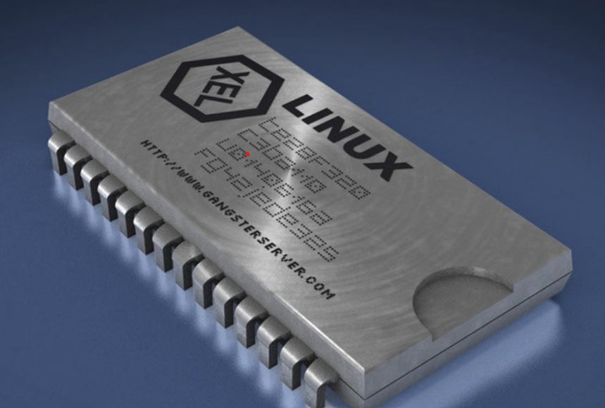
Linux Core Concepts
Page cache vs Buffer cache:
Page cache - When your system wants to do anything with data, which are written on a hard-disk, it firstly needs to read the data from the disk and store them in RAM. The memory allocated for these data is called pagecache.
Buffers - It contains the metadata which points to the actual files or data inside page cache.
Physical CPU vs Logical CPU
In short Physical CPU correlates to the actual physical cores present on the processor.
Socket(s) : the number of physical socket connects to one processor.
Core(s) per socket : It represents the count of the physical core (CPU) belongs to socket.
Thread(s) per core : it represents number of logical CPU counter under each core.
Number of logical cores =“Thread(s) per core” × “Core(s) per socket” × “Socket(s)”
Number of physical cores = “Core(s) per socket” × “Socket(s)”.

Slide 8
Linux Performance metrics
CPU utilization
This is probably the most straightforward metric. It describes the overall utilization per processor – Anything more than 80% is a CPU bottleneck.
Load average - The number of processes in queue waiting to be processed
User Time : It is the CPU percentage spent on user processes
System Time : it is the CPU percentage spent on system/kernel process
Waiting : Total amount of CPU time spent waiting for an I/O operation to occur.
Idle time : the CPU percentage the system was idle waiting for tasks
Nice Time : it is the CPU percentage spent on re-nicing processes that change the execution order and priority of process.
Context switch : Number of switches between threads that occur on the system.
Memory utilization
Free Memory
Swap Memory
Page cache and buffer cache

Slide 9
Linux Performance metrics
Disk Utilization
Iowait Time : The CPU spends waiting for an I/O operation to occur. High and sustained values most likely indicate an I/O bottleneck
Average queue length : Amount of outstanding I/O requests. In general, a disk queue of 2 to 3 is optimal; higher values might point toward a disk I/O bottleneck.
%Disk Utilization - Percentage of disk usage on the system
Read/writes per sec - amount disk read/second and writes/second
Network interface metrics
Packets received and sent - This metric informs you of the quantity of packets received and sent by a given network interface
Bytes received and sent - his value depicts the number of bytes received and sent by a given network interface
Packets dropped - This is a count of packets that have been dropped by the kernel, either due to a firewall configuration or due to a lack of network buffers.

Slide 10
Linux – Performance Monitoring Tools
Uptime
TOP
Pidstat
dmesg | tail
Vmstat
Iostat
Mpstat
Disk space usage(du, df)
Free
Ps
Sar

Slide 11
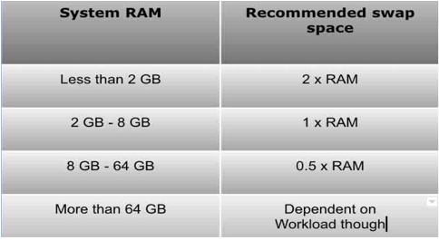
Linux – Performance Monitoring Tools

Slide 12
Linux – Performance Monitoring Tools
Problem : High CPU usage
Tools to use
1.Uptime - To check load average over time
2.Vmstat - To check the CPU usage caused by us, sys, wa, st
Vmstat –n 1
3.Dmesg: Provides vital information that can be used for troubleshooting production performance problems.
dmesg | tail -20 ,dmesg | head -20,dmesg | grep -i memory, sudo dmesg -xL | tail -20, sudo dmesg -xTL | tail -20
4.Top –To check the overall CPU usage by process wise and summary about the system.
top shift+M - sort by cpu usage ; top shift+P – sort by memory usage ; Top –H –p <pid> - thread wise stats
5. mpstat- prints CPU time breakdowns per CPU , which helps to check the processor imbalance.
mpstat 1; mpstat –P ALL 1 mpstat -u -P ALL 2
6. Sar : system activity report - you can use -P to check CPU usage per core. sar -P ALL 1 2
7.Pidstat - Pidstat is a little like top’s per-process summary but prints a rolling summary instead of clearing the screen.
pidstat –d ( provides disk usage per process level)
pidstat –w ( provides context switches per process level)
pidstat –p <PID> ( provide process wise usage).
$ pidstat -w -u 1
# 1 means output interval is 1 second # -w: output process switching index， # -u: output CPU usage index
pidstat -rwht -p <pid> <interval> ; example pidstat -rwht -p 2530 2
pidstat –rdwuh –p <pid>
8. You can count threads with the list of available sub directories inside /proc/<PID>/task/
cat /proc/<pid>/task
cat /proc/$(pgrep java)/status | grep -i Threads
9.cputool — CPUTool is a utility which manages CPU usage and system load
cputool --cpu-limit 50 -p 8275

Slide 13
Linux – Performance Monitoring Tools
Problem : High Memory usage
Tools to use
1.free - To check load average over time
2.Vmstat - To check the CPU usage caused by us, sys, wa, st : Vmstat –n 1
3.Top –To check the overall Memory usage by process wise and summary about the system.
top shift+M - sort by cpu usage ; top command and press f and select swap and press space and press q.
4.Pidstat - Pidstat is a little like top’s per-process summary but prints a rolling summary instead of clearing the screen.
pidstat -rwht -p <pid> <interval> ; example pidstat -rwht -p 2530 2
pidstat –rdwuh –p <pid>
5.Swap memory usage scripts – To check the swap memory per process.

Slide 14
Linux – Performance Monitoring Tools
Problem : High Disk usage
Tools to use
2.Vmstat - To check the CPU usage caused by us, sys, wa, st
Vmstat –n 1
3.Dmesg: Provides vital information that can be used for troubleshooting production performance problems.
dmesg | tail -20 ,dmesg | head -20,dmesg | grep -i memory, sudo dmesg -xL | tail -20, sudo dmesg -xTL | tail -20
4.Top –To check the overall CPU usage by process wise and summary about the system.
top shift+M - sort by cpu usage ; top shift+P – sort by memory usage ; Top –H –p <pid> - thread wise stats
5. Iostat - iostat -hx 1 2
6.Pidstat - Pidstat is a little like top’s per-process summary but prints a rolling summary instead of clearing the screen.
pidstat –d ( provides disk usage per process level)
pidstat –rdwuh –p <pid
7. iotop

